Slide 1
Historical Use Of Zero Generation Flexibility 2004 – Current 1/4/2022

Slide 2
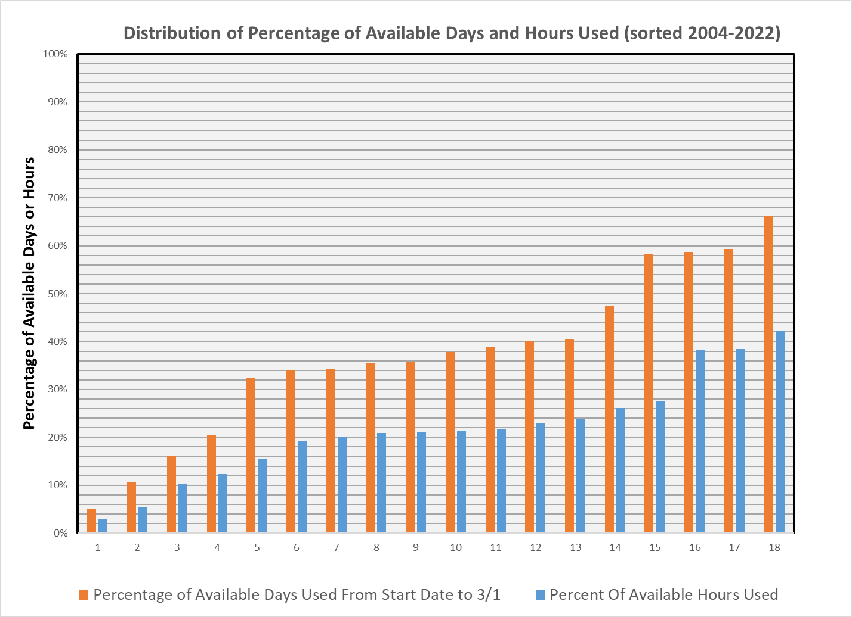

Slide 3
Percentage of Available Hours Used Between Official Start Dates Through the End of February
 | LWG | LGS | LMN | IHR | Average
2004-2005 | 36.5% | 46.6% | 45.9% | 39.5% | 42.1%
2005-2006 | 0.8% | 2.6% | 4.9% | 3.8% | 3.0%
2006-2007 | 8.0% | 14.9% | 14.4% | 12.0% | 12.4%
2007-2008 | 11.5% | 21.9% | 24.5% | 27.2% | 21.3%
2008-2009 | 18.1% | 20.8% | 20.3% | 17.8% | 19.3%
2009-2010 | 21.6% | 30.5% | 30.0% | 27.9% | 27.5%
2010-2011 | 19.6% | 22.6% | 22.4% | 19.8% | 21.1%
2011-2012 | 32.2% | 42.3% | 40.6% | 38.3% | 38.3%
2012-2013 | 26.8% | 31.9% | 24.5% | 12.5% | 23.9%
2013-2014 | 18.6% | 24.7% | 23.1% | 20.4% | 21.7%
2014-2015 | 4.6% | 17.0% | 11.0% | 8.7% | 10.3%
2015-2016 | 19.3% | 21.7% | 19.7% | 19.7% | 20.1%
2016-2017 | 18.5% | 23.1% | 20.8% | 21.1% | 20.9%
2017-2018 | 8.0% | 9.6% | 0.5% | 3.5% | 5.4%
2018-2019 | 30.2% | 37.9% | 29.1% | 7.2% | 26.1%
2019-2020 | 39.9% | 43.5% | 40.6% | 29.6% | 38.4%
2020-2021 | 17.0% | 18.7% | 15.9% | 10.9% | 15.6%
2021-2022 | 9.8% | 29.0% | 26.9% | 25.9% | 22.9%
Average Percentage of Available Hours Used | 19.0% | 25.5% | 23.1% | 19.2% | 21.7%

Slide 4
Percentage of Available Days Used Between Official Start Dates Through the End of February
 | LWG | LGS | LMN | IHR | Average
2004-2005 | 60% | 71% | 70% | 64% | 66%
2005-2006 | 1% | 4% | 9% | 7% | 5%
2006-2007 | 13% | 25% | 24% | 20% | 20%
2007-2008 | 26% | 38% | 48% | 49% | 40%
2008-2009 | 31% | 35% | 32% | 32% | 32%
2009-2010 | 36% | 51% | 53% | 51% | 48%
2010-2011 | 33% | 35% | 35% | 34% | 34%
2011-2012 | 52% | 60% | 61% | 61% | 59%
2012-2013 | 45% | 51% | 41% | 19% | 39%
2013-2014 | 32% | 38% | 38% | 35% | 36%
2014-2015 | 8% | 20% | 20% | 17% | 16%
2015-2016 | 34% | 35% | 34% | 34% | 34%
2016-2017 | 33% | 38% | 36% | 36% | 36%
2017-2018 | 16% | 17% | 1% | 8% | 11%
2018-2019 | 46% | 55% | 48% | 13% | 41%
2019-2020 | 59% | 64% | 63% | 51% | 59%
2020-2021 | 42% | 43% | 37% | 29% | 38%
2021-2022 | 13% | 80% | 73% | 67% | 58%
Average Percentage Of Days Used | 32% | 42% | 40% | 35% | 37%

Slide 5
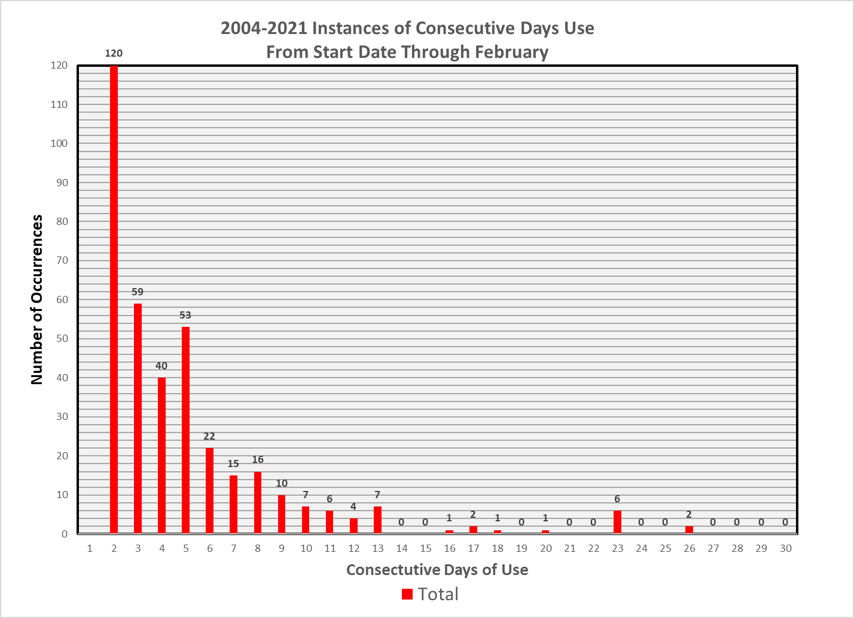

Slide 6
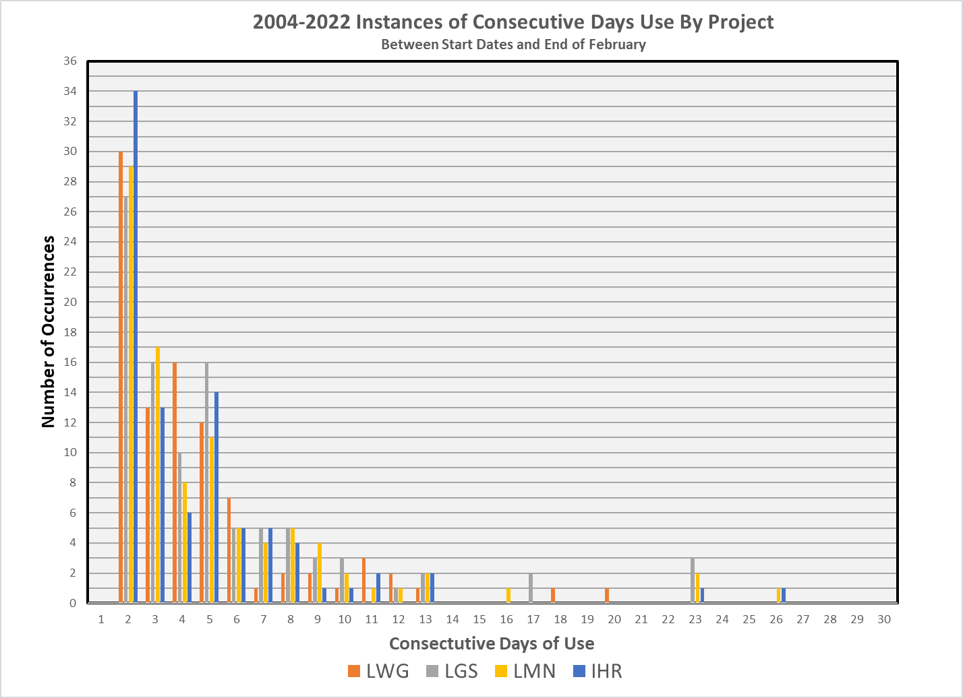

Slide 7
Instances of Consecutive Days of Use Between Official Start Dates Through the End of February
Days of Consecutive Use | LWG | LGS | LMN | IHR | Total
2 | 30 | 27 | 29 | 34 | 120
3 | 13 | 16 | 17 | 13 | 59
4 | 16 | 10 | 8 | 6 | 40
5 | 12 | 16 | 11 | 14 | 53
6 | 7 | 5 | 5 | 5 | 22
7 | 1 | 5 | 4 | 5 | 15
8 | 2 | 5 | 5 | 4 | 16
9 | 2 | 3 | 4 | 1 | 10
10 | 1 | 3 | 2 | 1 | 7
11 | 3 | 0 | 1 | 2 | 6
12 | 2 | 1 | 1 | 0 | 4
13 | 1 | 2 | 2 | 2 | 7
14 | 0 | 0 | 0 | 0 | 0
15 | 0 | 0 | 0 | 0 | 0
16 | 0 | 0 | 1 | 0 | 1
17 | 0 | 2 | 0 | 0 | 2
18 | 1 | 0 | 0 | 0 | 1
19 | 0 | 0 | 0 | 0 | 0
20 | 1 | 0 | 0 | 0 | 1
21 | 0 | 0 | 0 | 0 | 0
22 | 0 | 0 | 0 | 0 | 0
23 | 0 | 3 | 2 | 1 | 6
24 | 0 | 0 | 0 | 0 | 0
25 | 0 | 0 | 0 | 0 | 0
26 | 0 | 0 | 1 | 1 | 2
27 | 0 | 0 | 0 | 0 | 0
28 | 0 | 0 | 0 | 0 | 0
29 | 0 | 0 | 0 | 0 | 0
30 | 0 | 0 | 0 | 0 | 0

